Slide 1
WELCOME!
Girl Develop It is here to provide affordable and accessible programs to learn software through mentorship and hands-on instruction.
Some "rules"
We are here for you!
Every question is important
Help each other
Have fun

Slide 2
Upcoming Events
Oct 24 – Into to Arduino and Robotics Class
4hrs *$30.00
Nov 1 – Code & Coffee (free)
2016
Introduction to HTML and CSS
Introduction to Programming with Python
Introduction to Databases and SQL (I & II)
More!

Slide 3
Introduction to 3D Printing
“ I want to say one word to you. Just one word.…
Plastics”
The Graduate - 1967

Slide 4
Introductions
Name
Favorite ice cream or desert

Slide 5
What is 3D Printing
Additive Manufacturing (Legos)
Subtractive (carving, milling)
Material is pushed through a nozzle (extruded)
Filament is heated to allow this to happen
Icing or pastry bag
Hot Glue gun

Slide 6
Uses for 3D Printers
Prototyping
Small lot manufacturing (cookie cutters)
Specialized or hard to find items (car parts)
Education (music, animals)
To be determined!

Slide 7
My Favorite Thing
It was a Saturday morning….

Slide 8
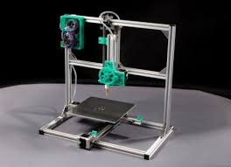
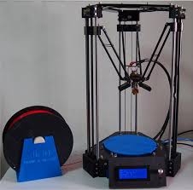
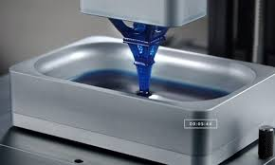
3D Pinter Types
Cartesian
Delta
DLP

Slide 9
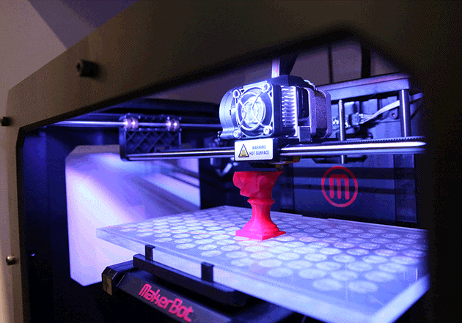
Cartesian

Slide 10
Delta

Slide 11

Delta Style Printer (video)
(https://www.youtube.com/watch?feature=player_embedded&v=zQxa920YGaU )

Slide 12
DLP

Slide 13
DLP Style Printer
(https://www.youtube.com/watch?feature=player_embedded&v=nxhUjPmxrP0 )

Slide 14
Money, Money, Money
Overall price range $500 - $2500+
Why the difference?
Technology (type) and build volume.

Slide 15
Differences
Technology (material)
Filament
PLA ($500 kit)
ABS (heated bed) (+$100)
Assembled (+$150)
Dual Head (+$200)
Resin (DLP)

Slide 16
Differences
Build Volume
4” x 4” x 4” ($400)
10” x 10” x 10” ($1000+)
7” x 15” x 7” DLP ($2500+)

Slide 17
Filament
Size 1.75mm (standard) & 3.00mm (old)
Material
PLA (Strong, stiff, fast print)
ABS (Heated bed, higher temp, slight flex)
Flex (rubber like)

Slide 18
Filament Exotics
Material
Nylon (Very Strong, very high print temp)
Wood
Conductive
Metallic (bronze, iron, etc)
Ceramic

Slide 19
What to Print?
You need a 3D model (.stl file)
Use an existing model
www.thingiverse.com
Make your own model
Tinkercad (web based www.tinkercad.com )
Meshmixer
Blender (open source)
Autocad 123D Design

Slide 20
How to Print?
3D printers use GCode
Set of instructions (movement, speed, temp, etc)
(**** start.gcode for The Replicator, dual head ****)
M103 (disable RPM)
M73 P0 (enable build progress)
G21 (set units to mm)
G90 (set positioning to absolute)
M109 S065 T0 (set HBP temperature)
M104 S220 T0 (set extruder temperature) (temp updated by printOMatic)
…
G1 X-29.91 Y-29.91 Z0.1 F1080.0 E1.0
G1 X-23.5 Y-35.17 Z0.1 F1080.0 E1.3
G1 X-16.19 Y-39.08 Z0.1 F1080.0 E1.6
G1 X-8.25 Y-41.49 Z0.1 F1080.0 E1.9

Slide 21
Slicers
Convert Models to GCode
Skeinforge used in ReplicatorG (oldie but a goodie)
Repetier (includes Slic3r )
Slic3r
KISSlicer
Makerware (Makerbot)
Simplify3D ($$$)

Slide 22
Terminology / Settings
Layer Height
Shells
Infill
Support
Skirt (brim)
Raft

Slide 23
Terminology / Settings
Layer Height
0.1 mm, (fine)
0.2 mm, (med)
0.3 mm (coarse)

Slide 24
Bed Leveling is Important
Layer height (0.1, 0.2, 0.3mm)
1/64” ~ 0.4mm
Sheet of paper is ~ 0.05mm thick

Slide 25
Terminology / Settings
Shells –
How many layers around the outside
1,2,…? (2 is common, 4 or more extreme)

Slide 26
Terminology / Settings
Infill –
10% - 100%
10% - 20% is common

Slide 27
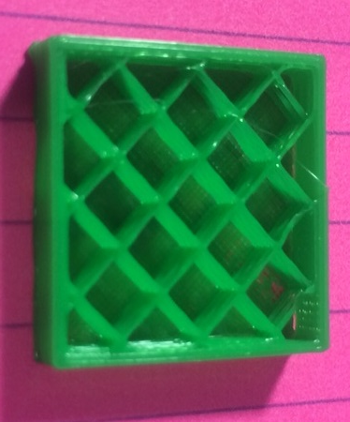
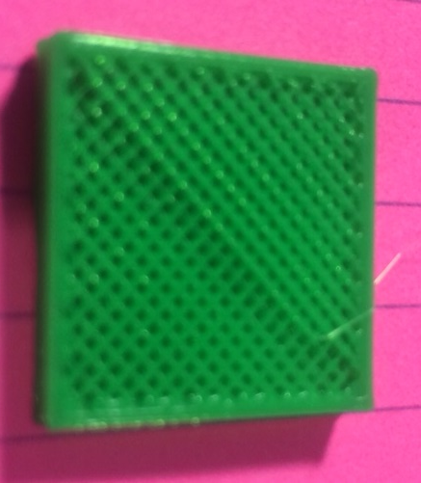
Infill
10%
40%

Slide 28
Terminology / Settings
Support
Printed material that is not part of the finished model
scaffolding

Slide 29
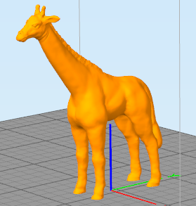
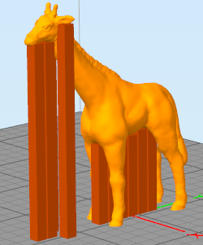
Support
Overhangs

Slide 30
Terminology / Settings
Skirt (brim)
Raft
These are both used to help the model stick to the build platform and reduce warping

Slide 31
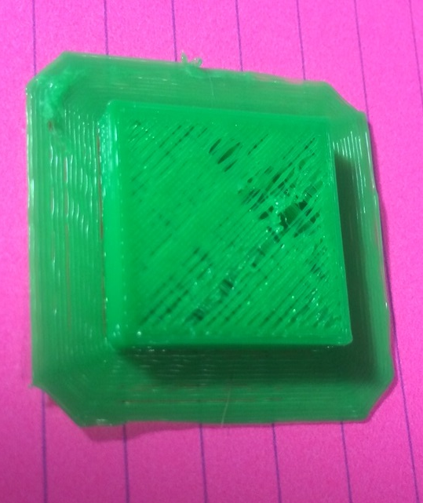
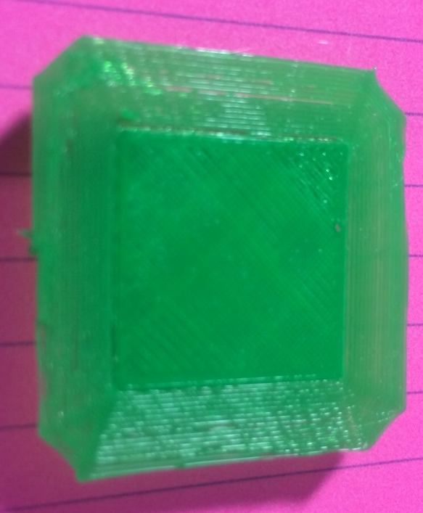
Skirt / Brim
Top
Bottom

Slide 32
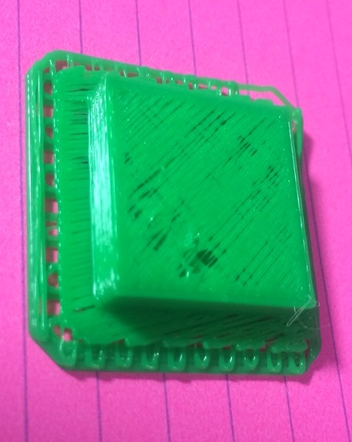
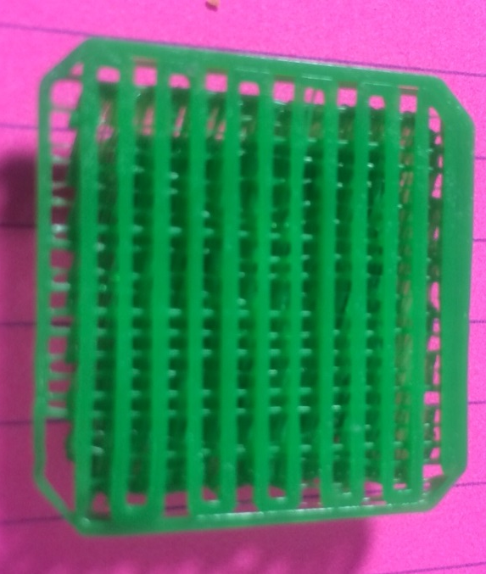
Raft
Top
Bottom

Slide 33
Stick It
First layer is the most important layer
Getting the first layer to adhere to the print bed
Painters tape (blue tape) – PLA only
Glass with hairspray
Kapton tape
ABS juice (ABS and acetone)

Slide 34
Danger! Danger! Will Robinson!
Plastic | Bed / Table |  | Nozzle
 | C | F | C | F
PLA | 0 – 65 | 0 - 149 | 200 - 210 | 392 – 410
ABS | 110 – 115 | 230 - 239 | 225 - 235 | 437 - 455

Slide 35
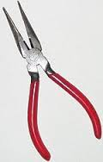
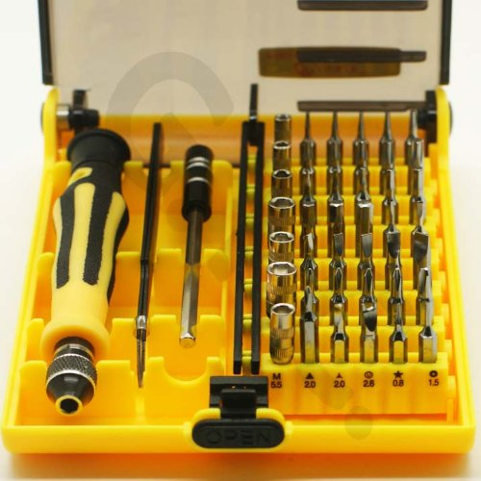
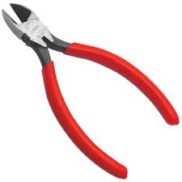
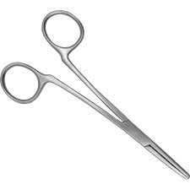
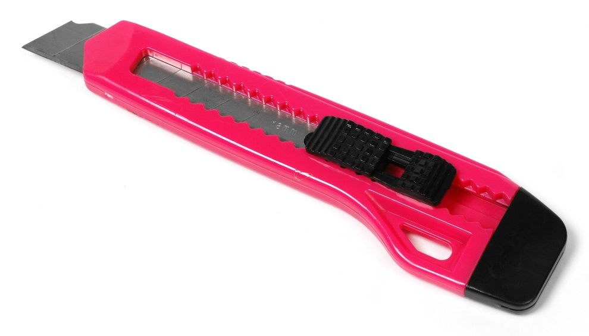
Common Tools

Slide 36
How Many ‘x’ Can I Print?
Matter is neither created nor destroyed
A standard spool of filament is 1kg (2.2 pounds)
Ukulele weighs about 425g (0.425kg) so it took just under half a spool of filament.
A cookie cutter weighs < 10g
1000g / 10 = 100 so you can print about 100 cookie cutters from a single 1kg (1000g) spool of filament.

Slide 37
Questions! (3D Printing Resources)
Models
www.thingiverse.com
Modeling Software
www.tinkercad.com
www.meshmixer.com
www.123dapp.com
www.blender.org (open source)
3D Slicing / Printing software
www.replicat.org (ReplicatorG )
www.repetier.com (Repetier)
www.slic3r.org (open source)
www.kisslicer.com (single printhead free)

